Slide 1






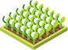

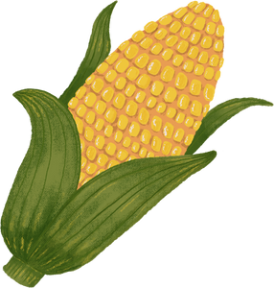

DATA MINING
CROP YIELD
PREDICTION
TEACHER: NGUYỄN HỒ DUY TRÍ
GROUP 7

Slide 2




Team Introduction
LÊ TRỊNH THANH THÚY
HỒ THỊ HẰNG
LÊ THỊ NGỌC HẢO
BÙI THỊ THANH NGÂN
19522325
20521285
20521292
20521643

Slide 3



Table of Content
TOPIC OVERVIEW
IMPLEMENTATION PROCESS

Slide 4


TOPIC OVERVIEW

Slide 5


How to improve prediction in agriculture?
What crops to grow and
what to do during the growing season of the crops?

Slide 6

IMPLEMENTATION PROCESS

Slide 7





PROCESS OF DATA ANALYSIS
Compose of
Deployment
Business Understanding
Data Exploration
Data Preparation
Data Modeling
Data Evaluation

Slide 8

DEPLOYMENT
The dataset is retrieved from Kaggle.
It consists of 2200 records of 22 various fruits & vegetabels.
According to actual data from India.

Slide 9

BUSINESS UNDERSTANDING
Domain: Agriculture
Business model: the user provides the parameters like N, P, K, temperature, humidity, ph value, rainfall from their side and the application will predict which crop should the user grow.

Slide 10






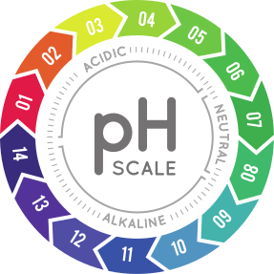
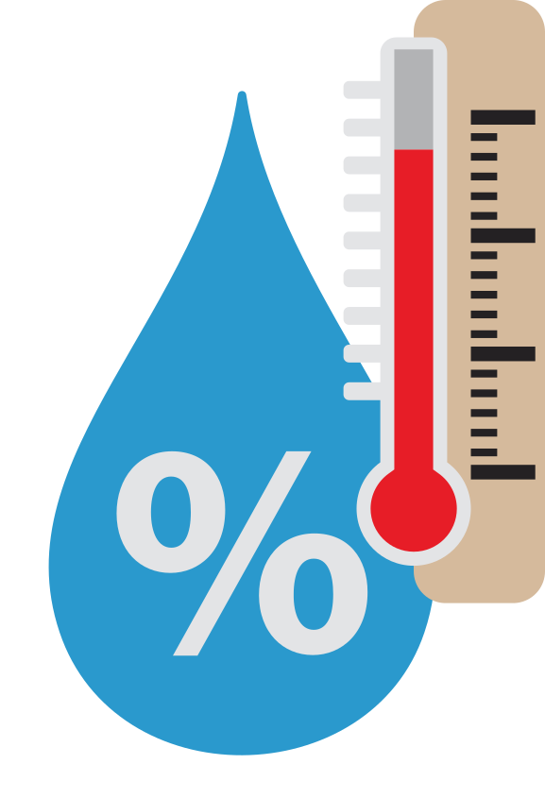


DATA EXPLORATION
Nitrogen (N)
Phosphorus (P)
Potassium (K)
Temperature
Humidity
PH value
Rainfall
Crop
Attributes in the dataset

Slide 11
DATA EXPLORATION
Attribute
Description
N
Ratio of Nitrogen content in soil
P
Ratio of Phosphorous content in soil
Description about data attributes
K
Ratio of Potassium content in soil
Temperature
Temperature in degree Celsius
Humidity
Relative humidity in %
PH
Ph value of the soil
Rainfall
Rainfall in mm
Label
Crop name

Slide 12
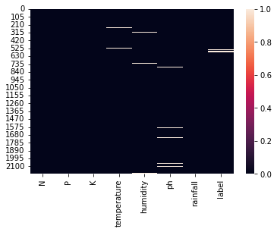
DATA PREPARATION
Missing value

Slide 13

DATA PREPARATION
Numbers of missing value in each columns
Features
Imputation
P
K
Impute
with "0"
Humidity ---------- 32
Temperature ------ 30
PH ----------------- 30
Rainfall ------------ 26
Label -------------- 20
K ------------------ 3
P ------------------ 1
Humidity
Temperature
PH
Rainfall
Mean
Label
Mode

Slide 14
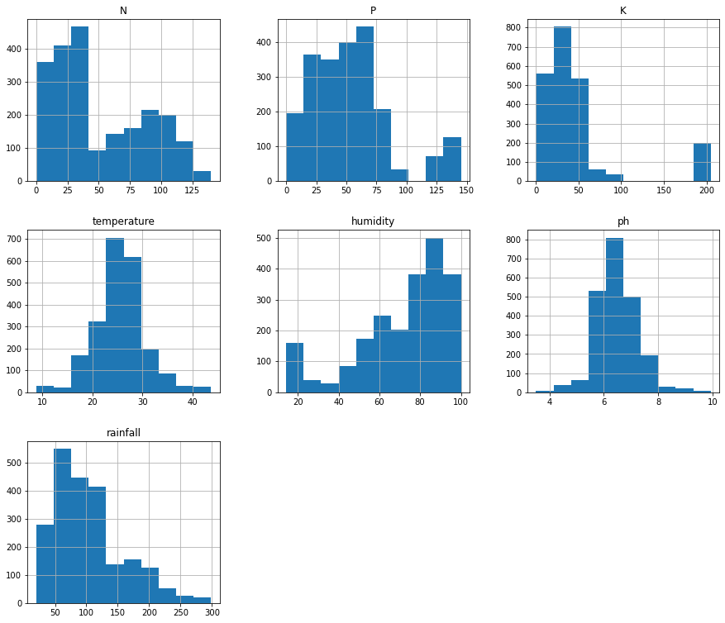
DATA PREPARATION
Distribution of variables

Slide 15
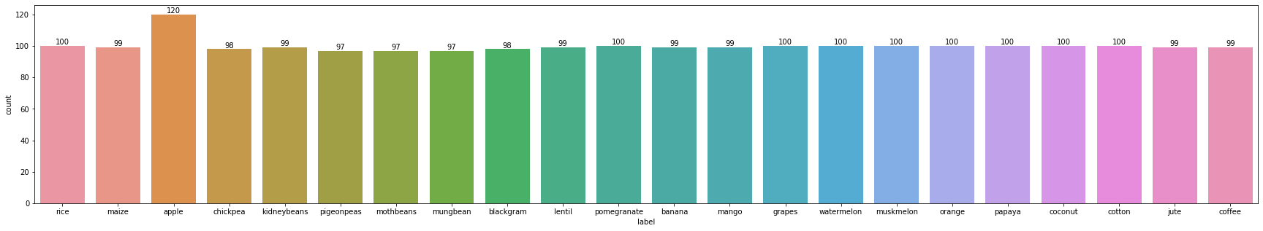
DATA PREPARATION
Visualizing 'label' attribute

Slide 16
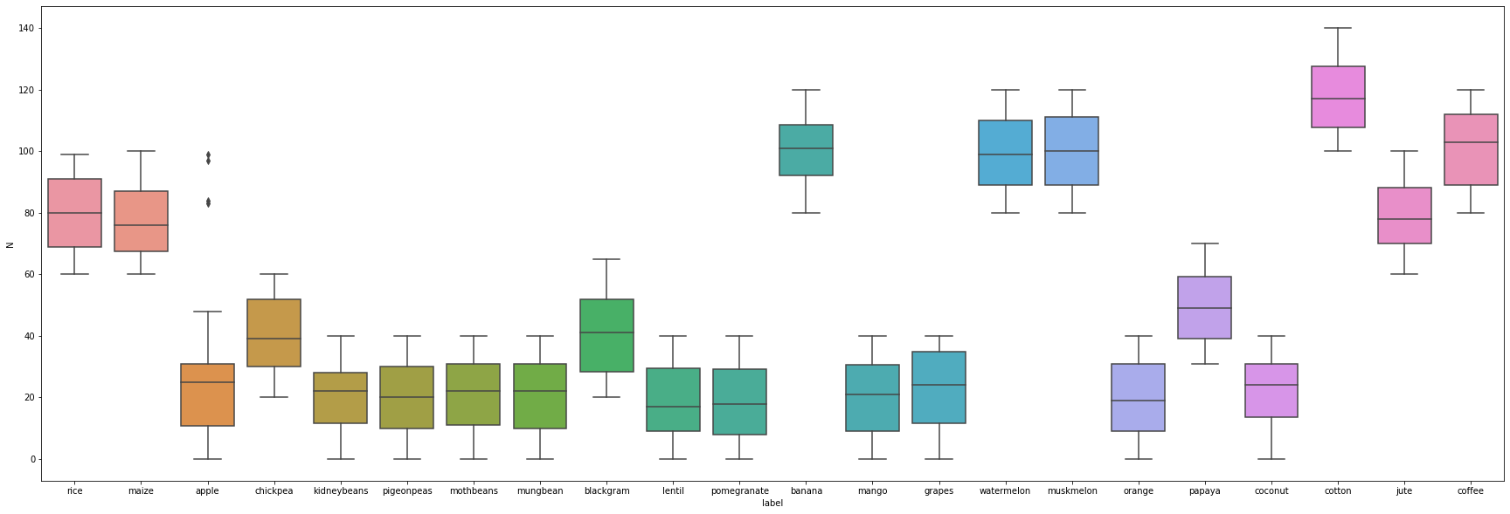
DATA PREPARATION
Pairing 'N' attribute with 'label' attribute

Slide 17
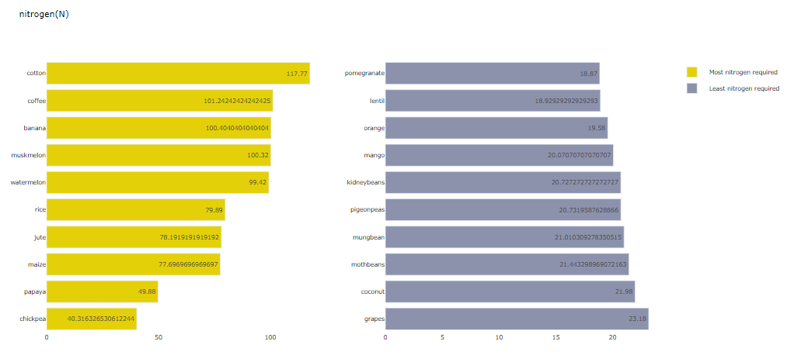
DATA PREPARATION

Slide 18
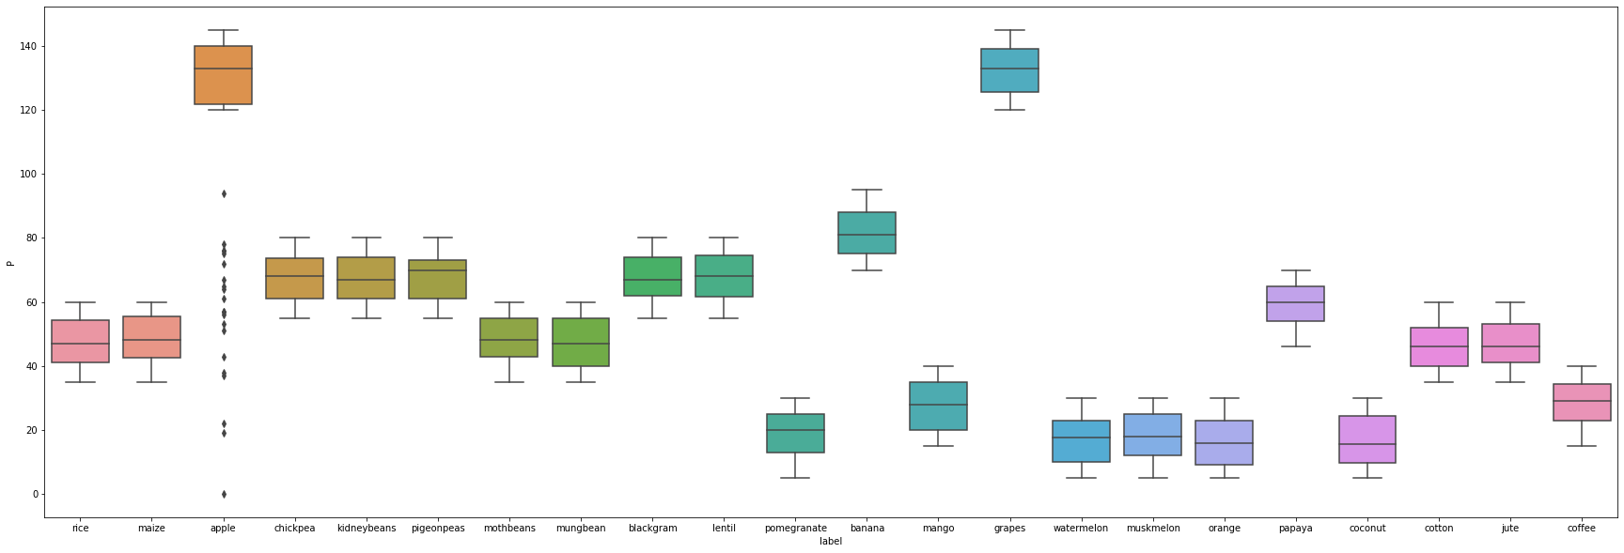
DATA PREPARATION
Pairing 'P' attribute with 'label' attribute

Slide 19
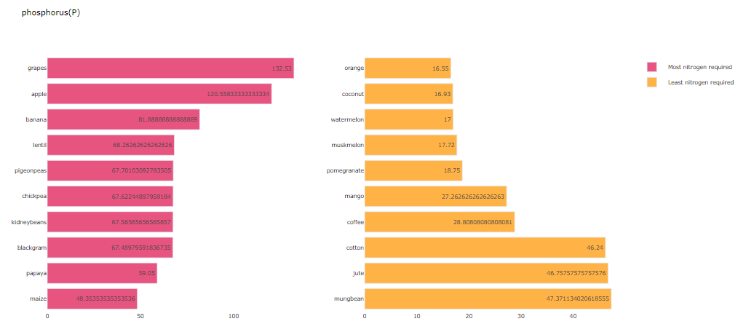
DATA PREPARATION

Slide 20
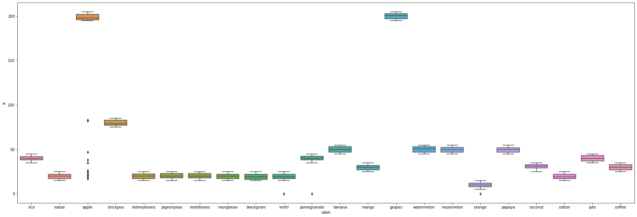
DATA PREPARATION
Pairing 'K' attribute with 'label' attribute

Slide 21
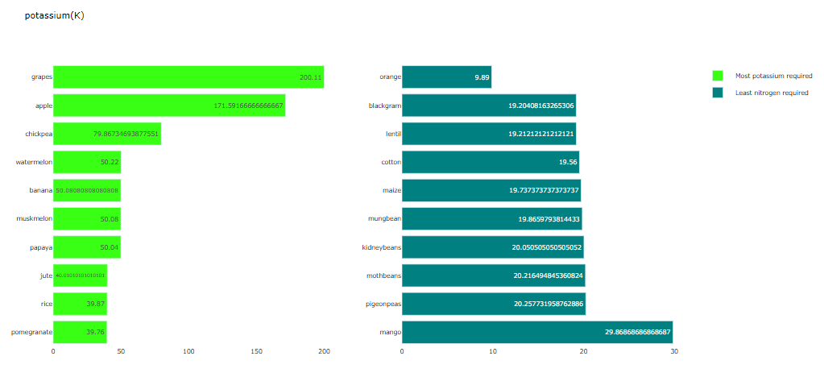
DATA PREPARATION

Slide 22
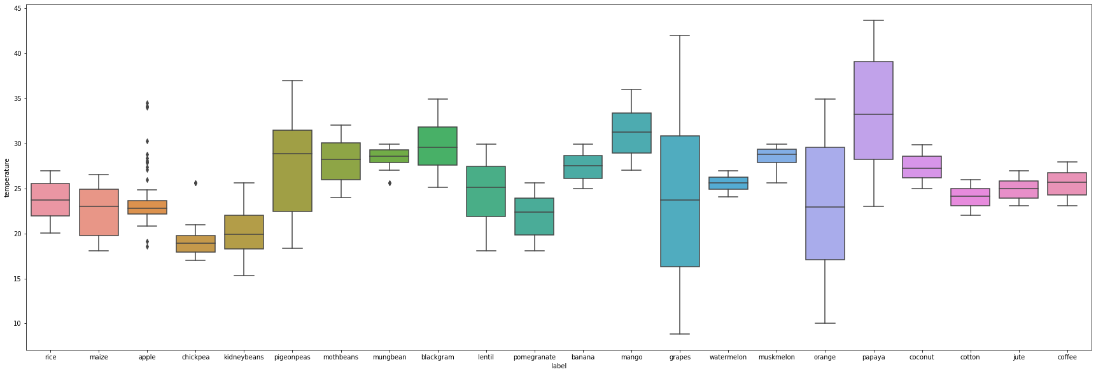
DATA PREPARATION
Pairing 'temperature' attribute with 'label' attribute

Slide 23
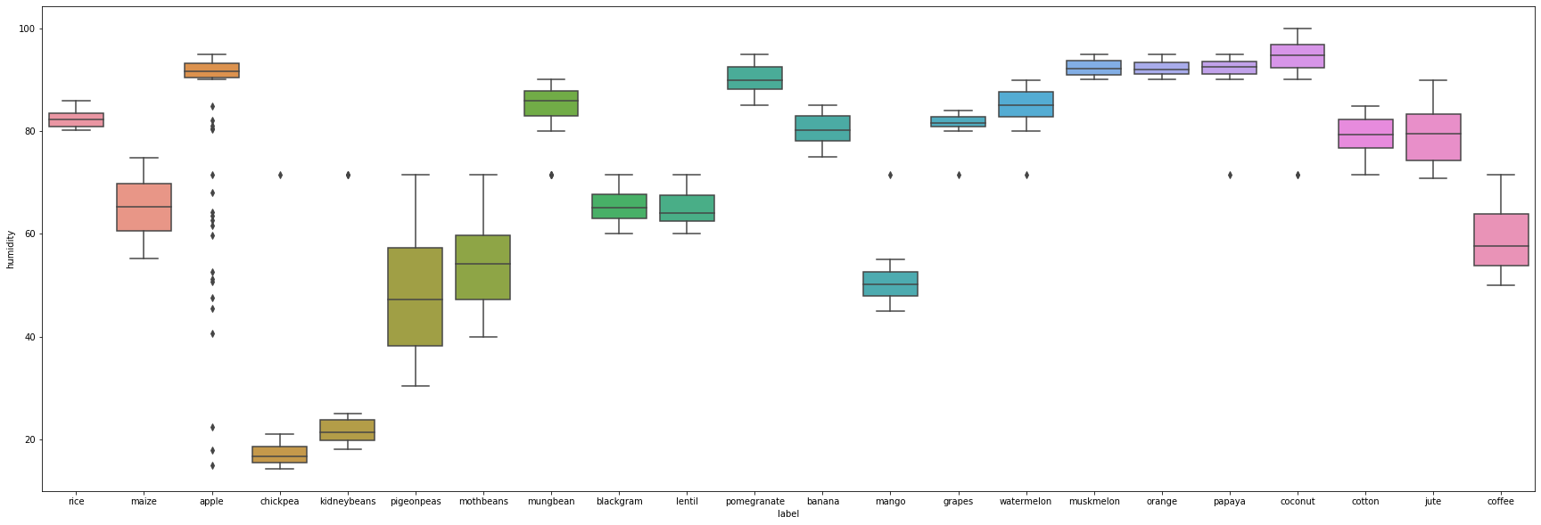
DATA PREPARATION
Pairing 'humidity' attribute with 'label' attribute

Slide 24
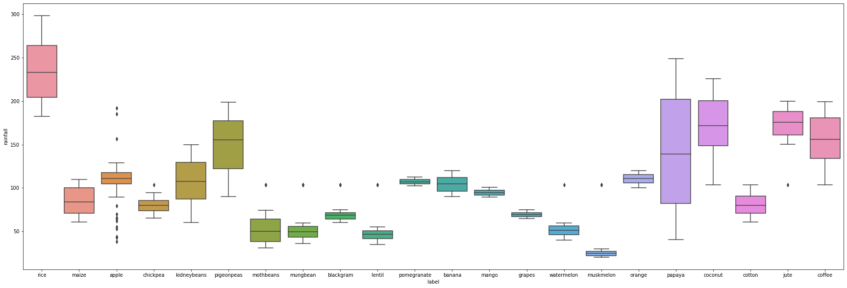
DATA PREPARATION
Pairing 'rainfall' attribute with 'label' attribute

Slide 25
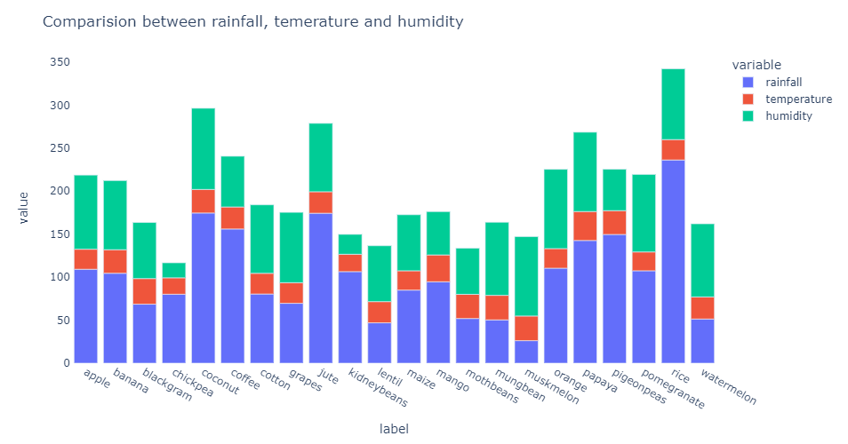
DATA PREPARATION

Slide 26
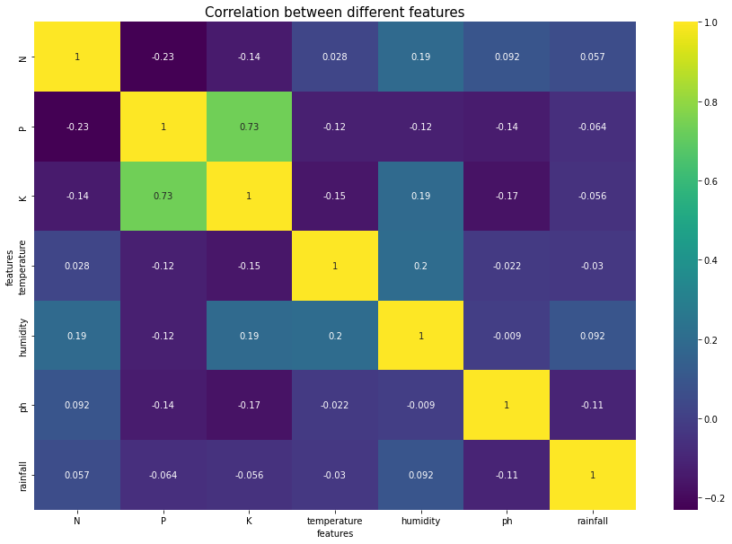
DATA PREPARATION
Correlation between different values

Slide 27
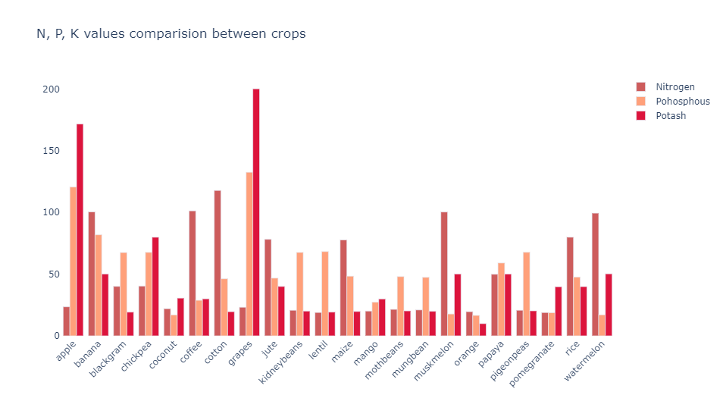
DATA PREPARATION

Slide 28


DATA PREPARATION
Adding 'Water Scarity' feature
high
medium
low

Slide 29
DATA PREPARATION
Type of variable
Transformation
Examples
Just ensure that the variable is numeric:
column.astype('float64')
Continous
N, P, K, temperature, humidity, PH, rainfall
Encode the variables:
[low, medium, high] -> [0, 1, 2]
Ordinal Categorical
Water Usage

Slide 30

DATA MODELING
N
P
K
Temperature
Humidity
Ph
Rainfall
Water Usage
Logistic Regression
Decision Tree
Random Forest
XGBoost
K Nearest Neighbors
Bagging Classifier
Crop Name

Slide 31
The purpose is to predict crop yield with Accuracy Score
We trained 6 models, which are proven to be effective, to predict crops based on crop parameters
N
P
K
Temperature
Humidity
Ph
Rainfall
Water Usage
Logistic Regression
Decision Tree
Random Forest
XGBoost
K Nearest Neighbors
Bagging Classifier
Crop Name

Slide 32
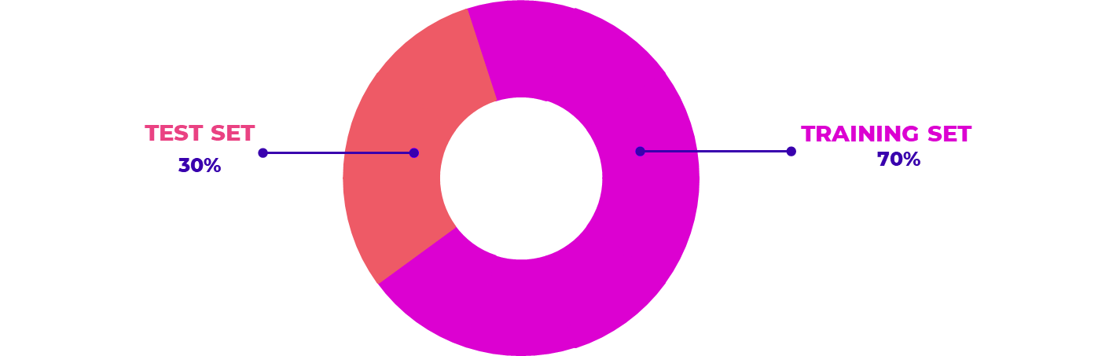
DATA MODELING

Slide 33
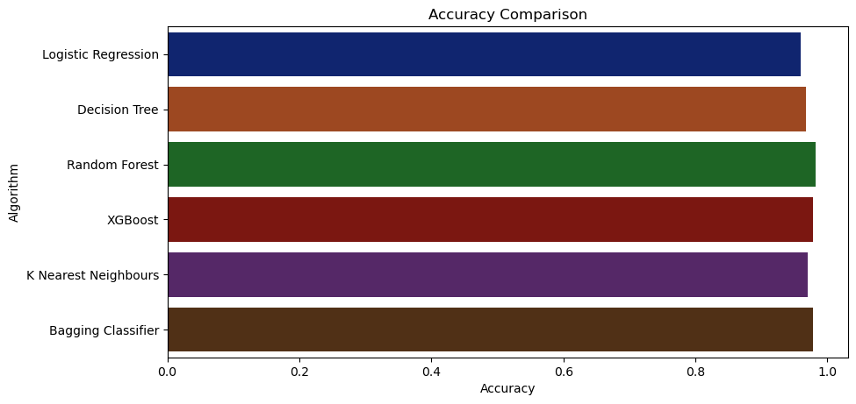
DATA EVALUATION

Slide 34
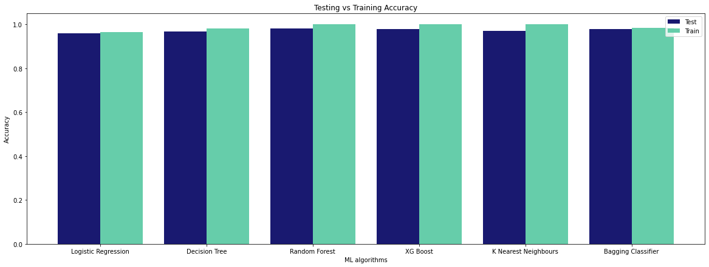
DATA EVALUATION

Slide 35

DATA EVALUATION
MODELS
ACCURACY SCORE
LOGISTIC REGRESSION
95.91 %
DECISION TREE
96.81 %
RANDOM FOREST
98.18 %
XGBOOST
97.87 %
K NEAREST NEIGHBORS
96.97 %
BAGGING
97.88 %

Slide 36





THANK YOU
FOR LISTENING

